Slide 1
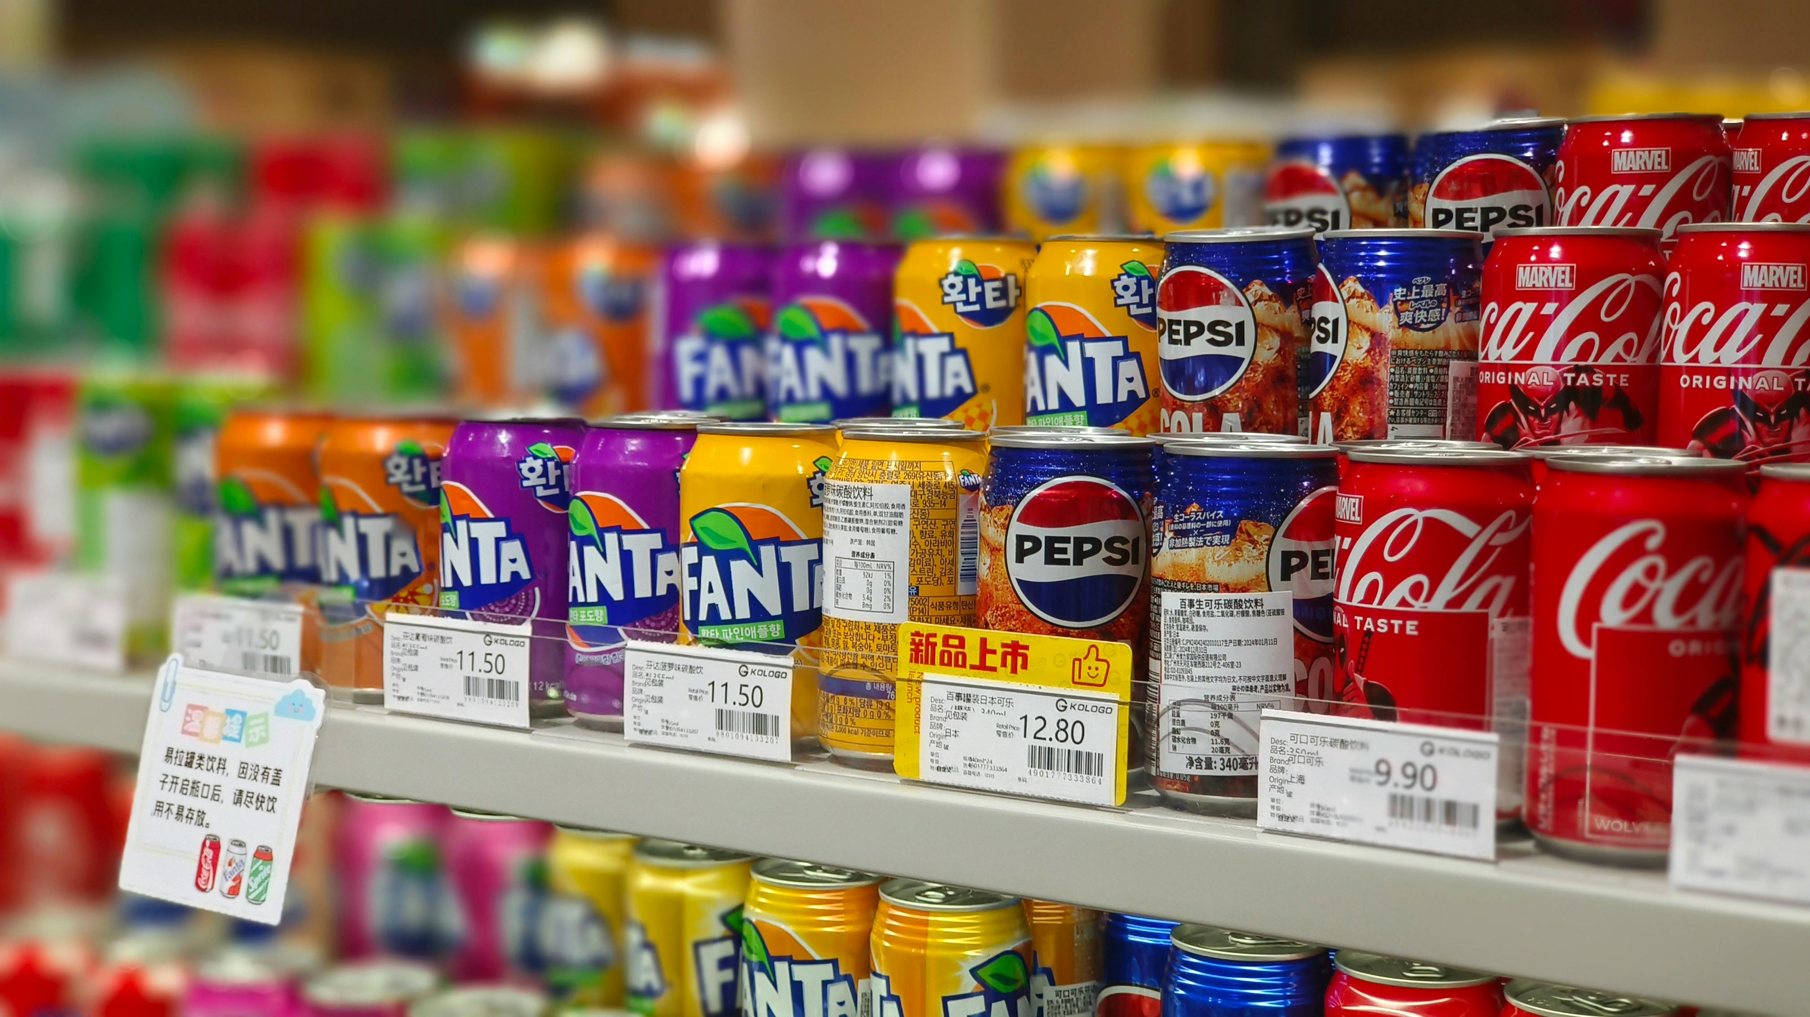

GLOBAL MART SALES DASHBOARD
- PowerPoint Presentation -

Slide 2





Key metrics presented in this report include total revenue generated, top five product brands, revenue by months, city with the highest revenue amongst others.
This report aims to review customer behavior, product performance and sales trend, which is meant to improve sales and would lead to a rise in revenue.
The analysis of this report was achieved using POWER BI. Various computations were made to arrive at key business metrics to drive decision making.

Slide 3
TABLE OF CONTENTS
EXECUTIVE SUMMARY
KEY FINDINGS/SOLUTIONS
RECOMMENDATIONS
CONCLUSION

Slide 4
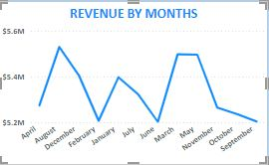
DASHBOARD
REVENUE BY MONTHS
A total revenue of $16,098,997 was achieved within the first quarter of the year 2023
A total revenue of approximately $16,000,000 was generated in the last quarter of the year 2023.
The highest revenue was generated in August totaling $5,529,249.84.

Slide 5
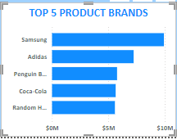
DASHBOARD
Penguin Books ranks third on the chart with a total revenue of $5,766.842..
Samsung tops the chart with a revenue of $9,921,705.80.
Coca Cola ranks 4th with a revenue of $5,642,993.93 .
Adidas ranks second with a total revenue of $7,235,562.04..
Random House ranks fifth with a total revenue of $5,575,454.48

Slide 6



RECOMMENDATIONS
Electronics should be given more investment capital as it brings in more revenue than other categories.
Young people are top patronizers because we have an array of product categories that appeals to them. Products that appeal to other age ranges can also be introduced.
Promos on product categories should be done in cities with less revenue to create awareness.

Slide 7

CONCLUSION

